Slide 1
Case Study ATHIRA PULICKAKUDY SALIN

Slide 2
FLOW
Outlier
Threshold
Skewness
K-Fold,best
Paramenters
Understanding
Problem
Missing Values
Sampling
Feature Engineering
Results and Interpetations
Data Imbalance
Model
Understanding
and Cleaning Data
Task
Scaling
Metrics
Correlation
Solution
Accuracy interpretations
Feature
Generation/Extraction
Optimal Features

Slide 3
Understanding Problem
Problem :- Predict the likelihood of an accommodation being clicked by a user (CTR)
Goal : - Based on the data, find an elegant way to perform binary classification to estimate prob(‘is_clicked_item’).

Slide 4
Understanding the Problem
Click-through rate (CTR)
important metrics for measuring eCommerce store performance.
Measures the number of people click on an ad.
Help evaluate how well the ads are resonating with the target audience.
It is a percentage of users who click on an ad.
CTR = Total Clicks/ Total impressions
Impressions are counts of how many times your ad appeared on the page.
The higher the CTR shows, the more likely users will convert into customers.
The lower CTR says ads aren’t resonating well with the audience.
Looking for sales from ads means a better conversion rate.
Good CTR for Google search ads is 3.17%
Good CTR for Google Display ads is 0.46%

Slide 5
Solution
Find an elegant way to perform a binary classification of the column ‘is_clicked_item’
The dataset contains numerical and categorical features and unique identifier columns.
The additional information provided as item.csv will contribute informative features.
Conduct a elaborate EDA to understand the data better.
Clean the data extensively to make it suitable for model implementation.
Study the importance of different features, consider the informative Features, and remove the less important features
Train on several models for binary classification and consider the best model
Understand the importance of Variables based on our model's learning and existing bias.
Speak to the Data

Slide 6
Understanding Data
Missing Values
Skewness
Imbalance Data
Outliers

Slide 7
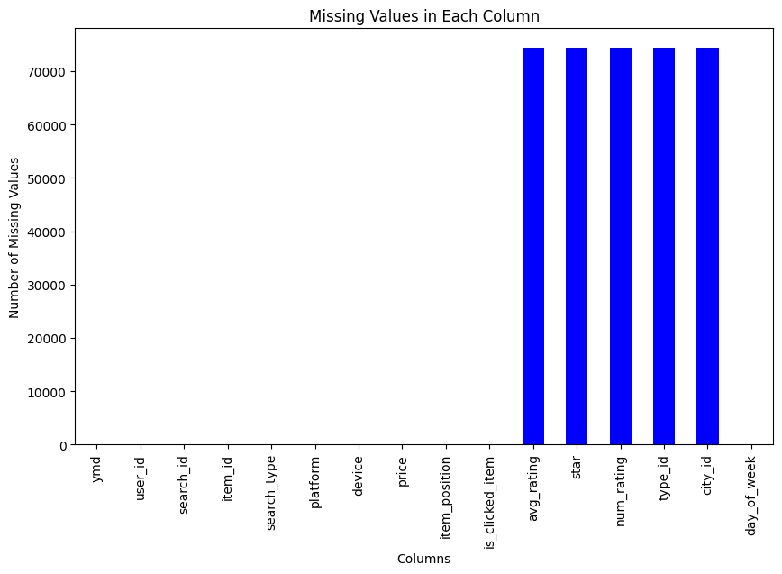
Missing Values
Merging item.csv with train.csv introduced missing values
Dropping those features may introduce loss of information
Ordinal values are imputed with mode
Id columns are imputed using mode by looking into their distribution
Let's Understand the distributions

Slide 8
Scaling the Features
A new column ’day_of_week’
The features are diverse:
Numerical features using StandardScaler
Id columns using frequency encoding
columns ‘star’ (ordinal) is right skewed so it is log-transformed
Fewer cardinality features are mapped
The ‘day_of_week’ feature is cyclical encoded

Slide 9
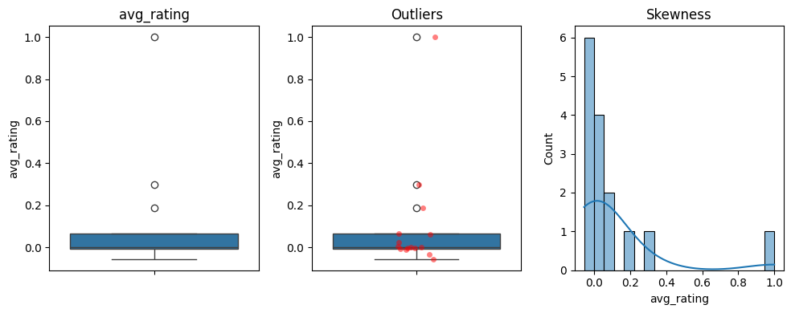
Outliers
avg_rating negatively skewed, and very few Outliers exist

Slide 10
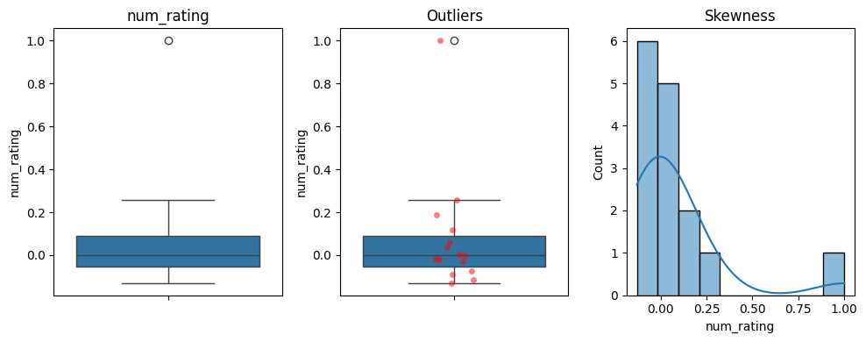
Outliers
num_rating left skewed, few outliers

Slide 11
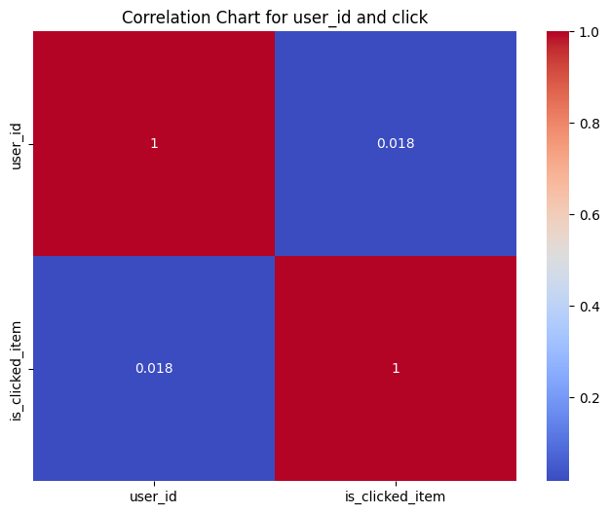



Correlation between target and numerical features
Multicollinearity,
Model Stability
Price - negatively correlated
user_id - is positively correlated
search_id -positively correlated
item_id – negatively correlated

Slide 12
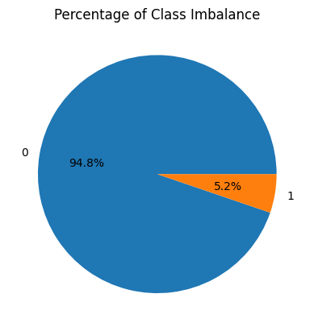
Imbalance Data
Accuracy Paradox
Oversampling, Not Under-sampling !!
Too less data to go for under-sampling of modelling data

Slide 13
Outliers
Applied TNSE on the data to remove outliers using one class SVM.
Principle component analysis can be done.
Found Few Outliers

Slide 14
Feature Engineering
Feature Extraction
Correlation
Feature Selection

Slide 15
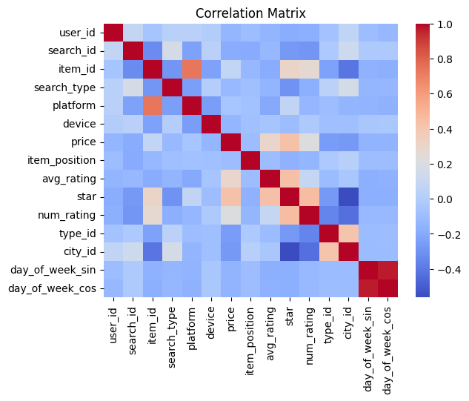
Correlation
The correlations between categorical data features can captured by chi-squared test.
The correlations between continuous numerical data features can be captured by one-Class anova and T-test.
Pearson Correlation is conducted here in scaled data
mRMR- Minimum redundancy Maximum Relevance algorithm

Slide 16
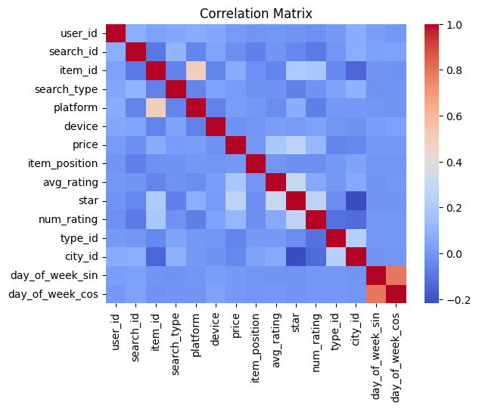
Correlation
Corrected correlation using threshold
Correlation matrix before and after removing highly correlated features

Slide 17
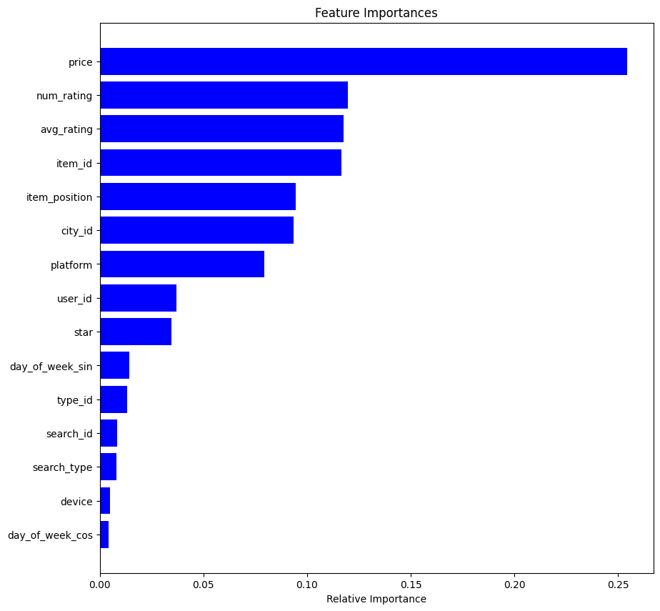
Feature Selection
Including all features may either over-fit or introduce variance to our model
More features also increase the flexibility of the model, which might end up with bad results on validating data set.
1 feature is dropped based on the feature importance’s and correlation (both categorical and continuous)
Reduce training time
Improved Accuracies

Slide 18
Model
Sampling
K-Fold
Evaluation
Threshold

Slide 19
Sampling
Modelling dataset contains highly imbalance classes
ML algorithms struggle with accuracy because of the unequal distribution in dependent variable.
This causes the performance of existing classifiers to get biased towards majority class.
Tried oversampling but best results comes with class weights
Avoid discarding useful information

Slide 20
K-Fold Evaluation
Random Forest, Gradient Boosting, AdaBoost and XGBoost are checked using a grid search
Gradient Boosting Classifier is chosen
5-Kfold model is ran to optimize the learning process.
Average AUC Is optimized in iteration
Best Parameters are chosen based on the K-Fold CV
The task ultimately is binary classification on ‘is_clicked_item’ and then to predict the probability of click (CTR)

Slide 21
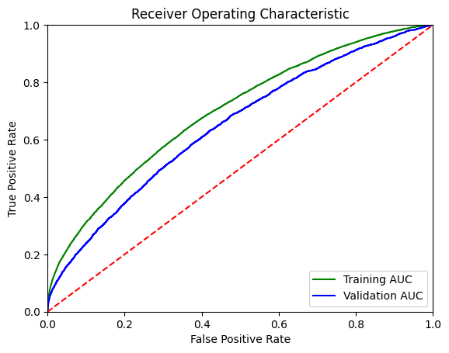
ROC AUC Curve
Precision vs Recall
Threshold from ROC Curve is taken as reference
5-Fold CV is ran to optimize threshold

Slide 22
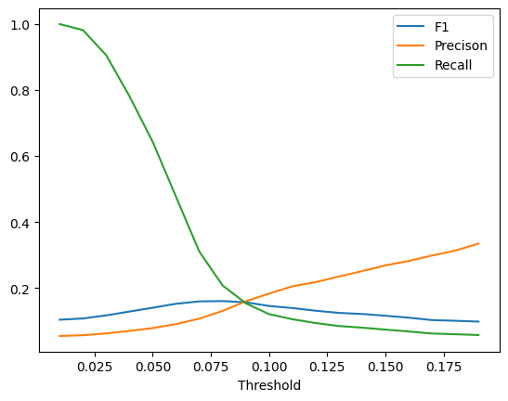
Threshold
Precision, F1 and recall is used to find optimal threshold = 0.08

Slide 23
Results and Interpretation
Metrics Choosen
Interpretations

Slide 24
Metrics Chosen
ROC curve: It can be used to select a threshold for a classifier which maximises the true positives, while minimising the false positives.
AUC: It can be used to compare the performance of two or more classifiers.
Confusion matrix: It can be used to understand the TP,TN,FP,FN and it can be used to understand the model performance.
Recall : TP / (TP+FP)
Precision : TP / (TP+FN)
F-Score : (2*Recall*Precision) / (Recall +Precision)

Slide 25
Accuracies & Interpretation
The Accuracies are presented for 5-Fold cross validation
Recall = 0.945103
Precision = 0.50000
Accuracy = 0.006993
F-Score = 0.013793
Threshold : 0.5
Later the optimal threshold is applied to make predictions on test data
Threshold : 0.08

Slide 26
Accuracies & Interpretation
The results shown here are for Training : 80%, Validatio: 20%
Trade-off between Precision and Recall
Accuracy is decided by business problem by allotting individual costs for classification (TP,FP, TN,FN costs)
Here the we found the optimal threshold and then predictions are made on test set

Slide 27
Summary
Data Preprocessing techniques used to prepare the dataset
Day of the week is added as an additional feature
Selected the important feature using feature importance and mRMR algorithm.
Price is the most influential factor in deciding if an ad gets clicked
Ratings are also important for the decision.
Then the best model that can do binary classification on ground truth is evaluated using a grid search and Gradient Boosting is the obtained best model.
Evaluation is conducted on the model results.
The optimal threshold is found to make the model realistic
The best model with optimal threshold is applied on test data prob(‘is_clicked_item’)
The main contributors to CTR are price and ratings

Slide 28
QUESTIONS ?

